Slide 1
BREAST CANCER PREDICTION USING ML ALGORITHM
Presented by
n.m.mehavarthini(batch – 7229)

Slide 2
Introduction What is machine learning and why are using?
Machine learning is a subset of artificial intelligence (AI). It is focused on teaching computers to learn from data and to improve with experience – instead of being explicitly programmed to do so.
In machine learning, algorithms are trained to find patterns and correlations in large data sets and to make the best decisions and predictions based on that analysis.
Machine learning applications improve with use and become more accurate the more data they have access to.
Applications of machine learning are all around us –in our homes, our shopping carts, our entertainment media, and our healthcare.

Slide 3
Breast Cancer Overview
Breast cancer is the second leading cause of cancer death in women, second only to lung cancer.
The leading risk factor for breast cancer is imply being woman. Though breast cancer does occur in men, the disease is 100 times more common in women.
Men can also get breast cancer. In 2017, the American Cancer Society extimates 2,470 new cases of invasive breast cancer will be diagnosed in men in the U.S.
A woman has about a one in eight chance of being diagnosed with breast cancer in her lifetime, according to the National Cancer Institute. Most women (about eight out of 10) who get breast cancer do not have a family history
But women who have close blood relatives with breast cancer have a higher risk. Having a first-degree relative (mother, sister or daughter) with breast cancer almost doubles a woman's risk.

Slide 4
Why I am using Machine Learning?
Breast Cancer Biopsy Data
Machine learning
Diagnosis

Slide 5
Understanding the Algorithm: Random Forest classifier
This algorithm creates a set of decision trees from a few randomly selected subsets of the training set and picks predictions from each tree.
Then by means of voting, the random forest algorithm selects the best solution.
Random forest algorithm works well because it aggregates many decision trees, which reduce the effect of noisy results, whereas the prediction results of a single decision tree may be prone to noise.
Random forest algorithm can be applied to build both classification and regression models.
In the case of a random forest classification model, each decision tree votes; then to get the final result, the most popular prediction class is chosen.
In the case of random forest regression model, the mean of all decision tree results is considered as the final result.

Slide 6
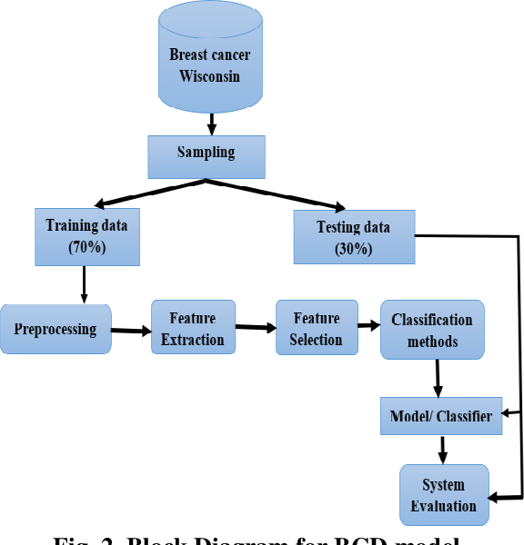
Flow Chart

Slide 7
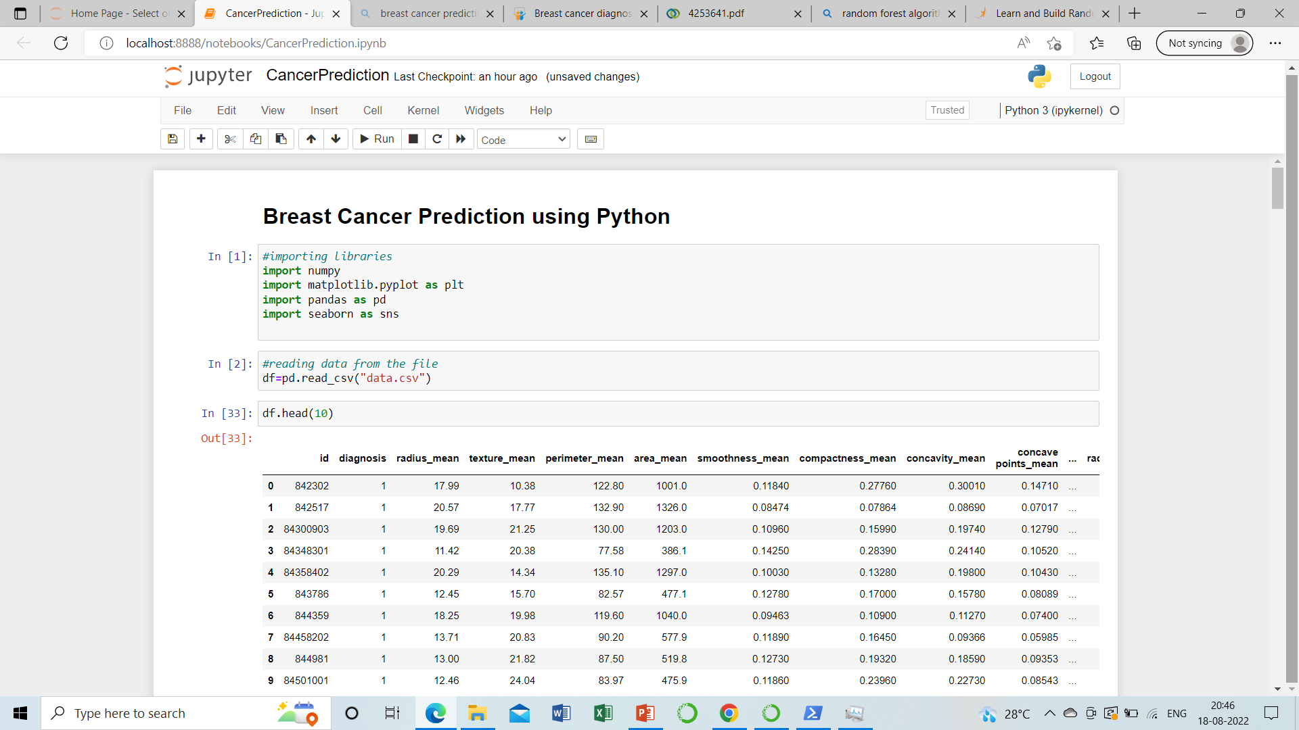
Take a view of dataset

Slide 8
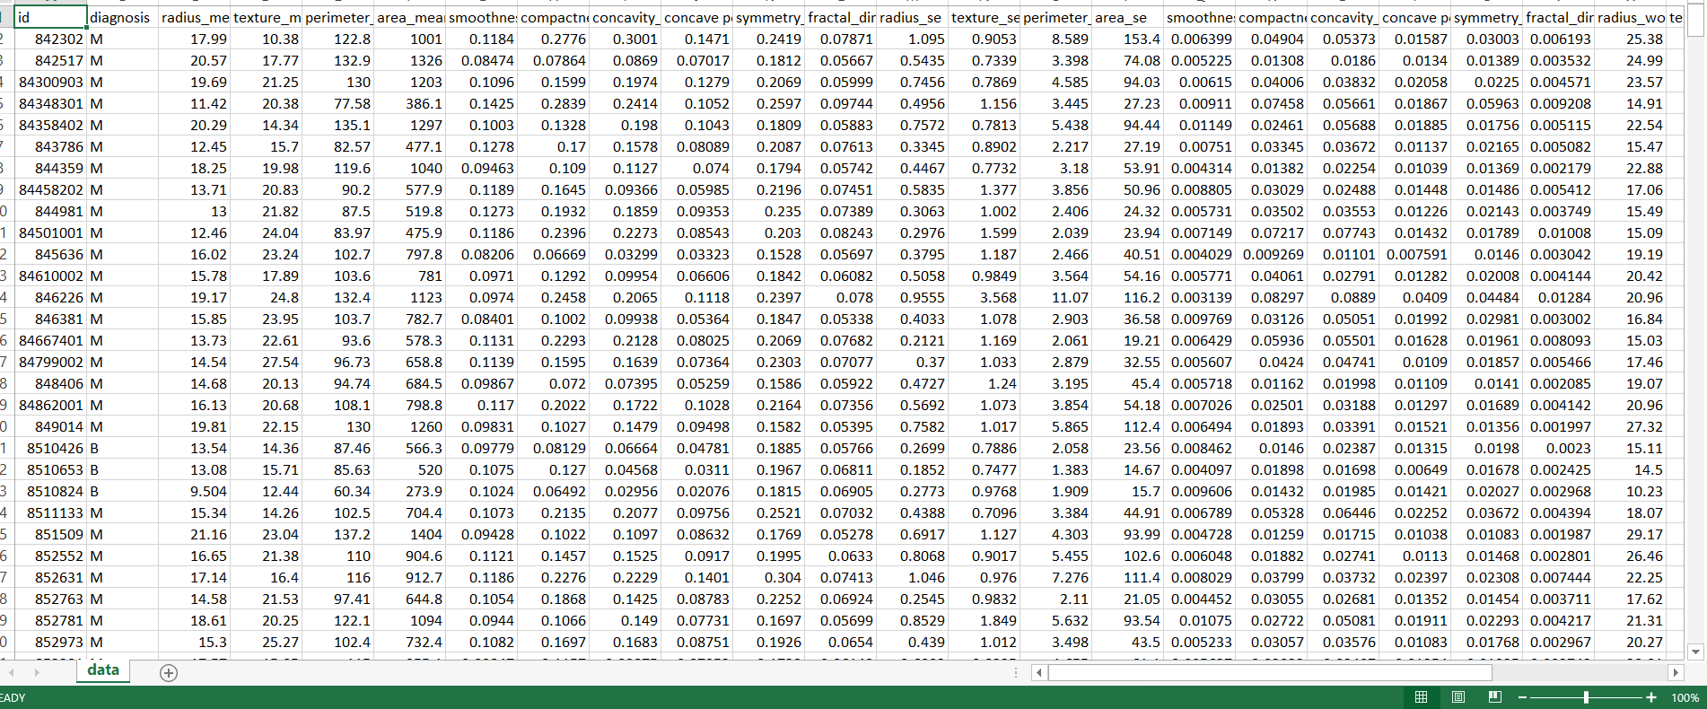
Step 1 - collecting data
We will utilize the Wisconsin Breast Cancer Diagnostic dataset from the UCI Machine Learning Repository at http://archive.ics.uci.edu/ml. This data was donated by researchers of the University of Wisconsin. The breast cancer data includes 569 examples of cancer biopsies, each with 32 features.

Slide 9
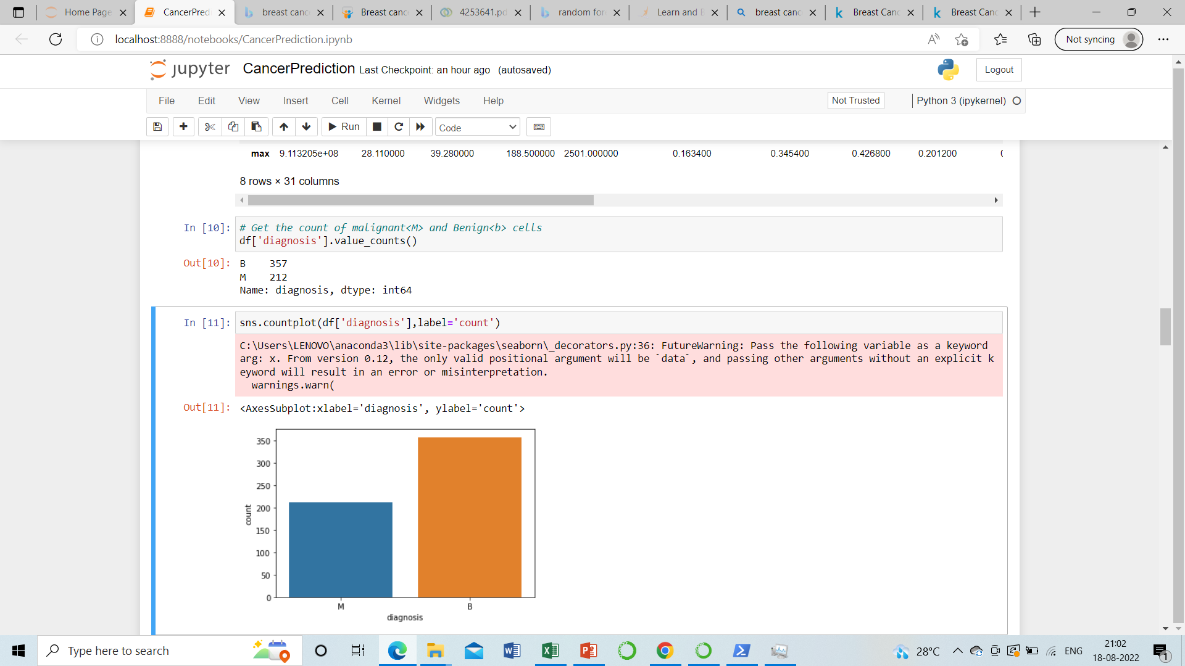
Step 2 - Exploring the data
Importing the data set in python
The table() output indicates that 357 masses are benign while 212 are malign

Slide 10
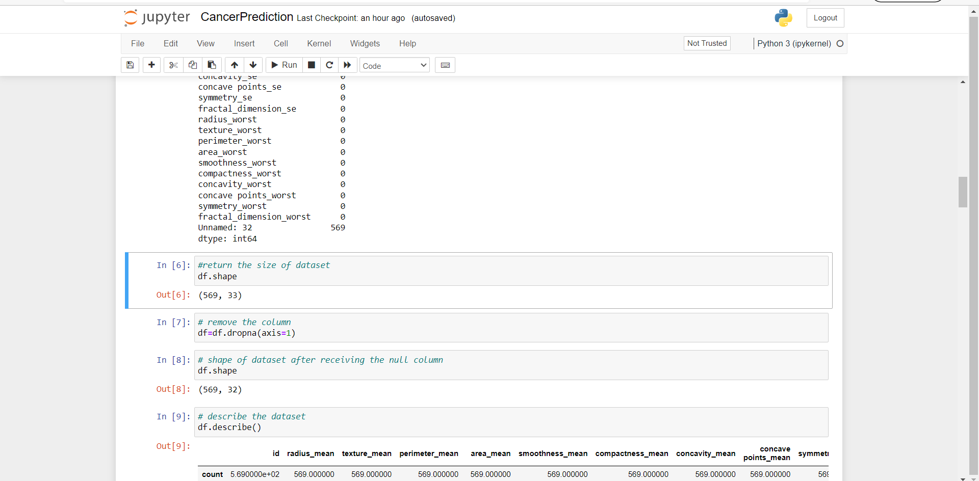
Preparing the data
Data preprocessing, a component of data preparation, describes any type of processing performed on raw data to prepare it for another data processing procedure.
It has traditionally been an important preliminary step for the data mining process.

Slide 11
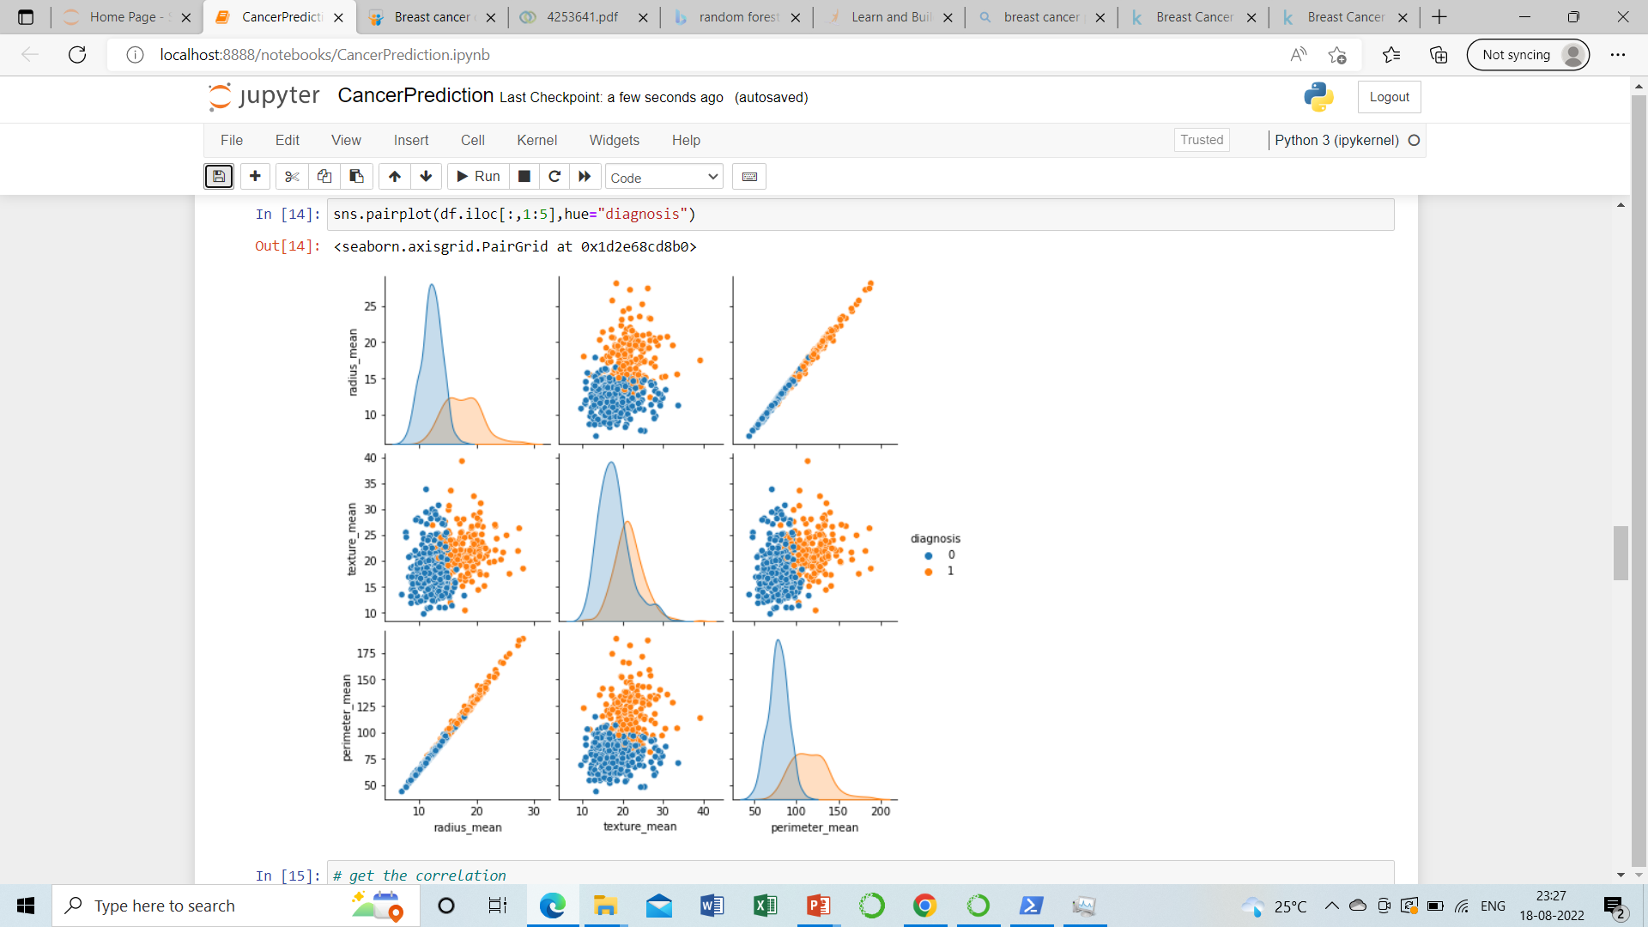
DATA VISUALIZATION
Data visualization is defined as a graphical representation that contains the information and the data.
The main goal of data visualization is to make it easier to identify patterns, trends and outliers in large data sets.

Slide 12
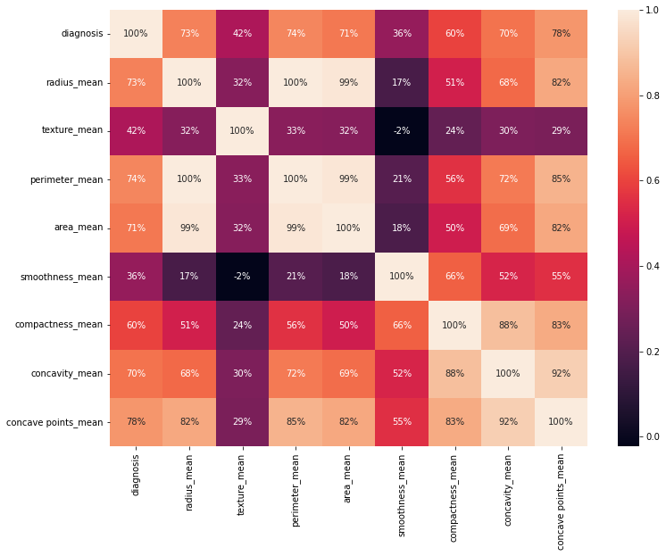
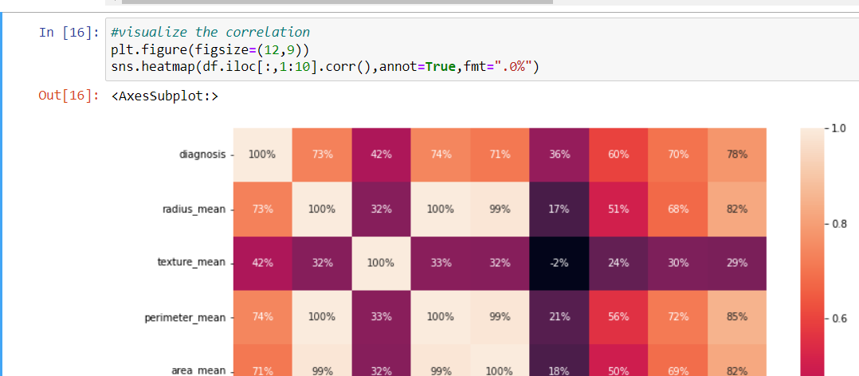
DATA VISUALIZATON
Visualising the correlation

Slide 13
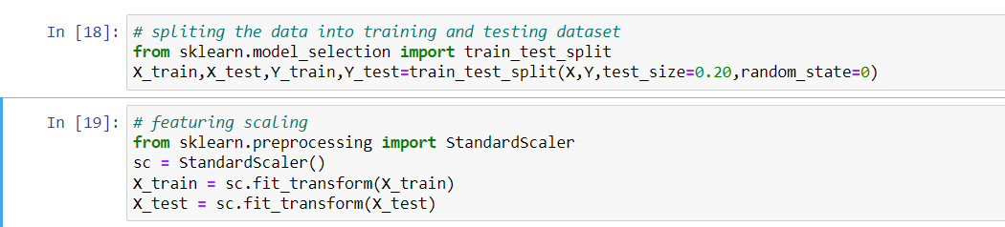
Training and testig data
We use Cross Validation to assess the predictive performance of the models and and to judge how they perform outside the sample to a new data set also known as test data. So our classifier is first trained on the train set( usually 70% of the total data) and then tested on the test set( usually rest 30% of the data which the classifier has not seen) on the basis of which accuracy is computed.

Slide 14
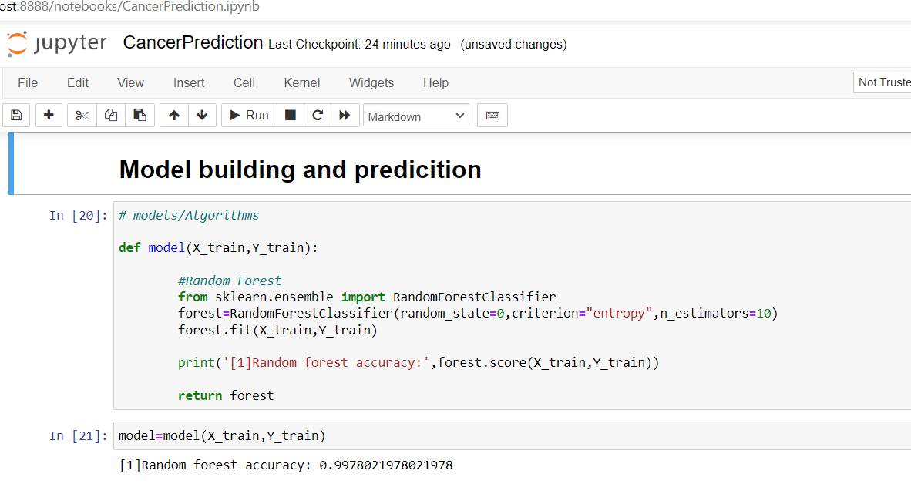
MODEL THE BULIDING
Perform machine learning optimisation.
Deploy the model.

Slide 15
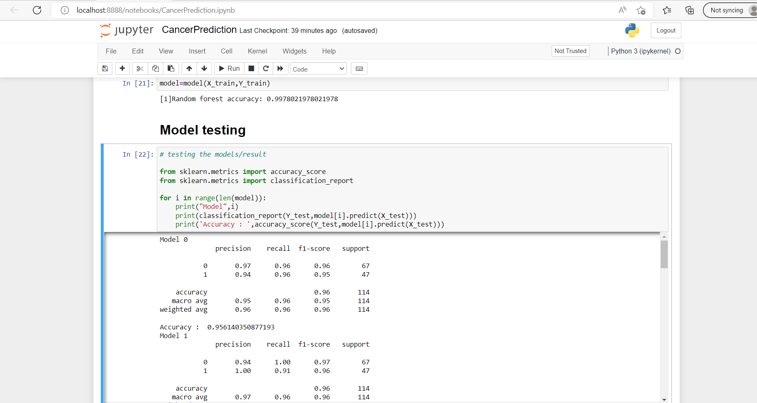
MODEL TESTING

Slide 16
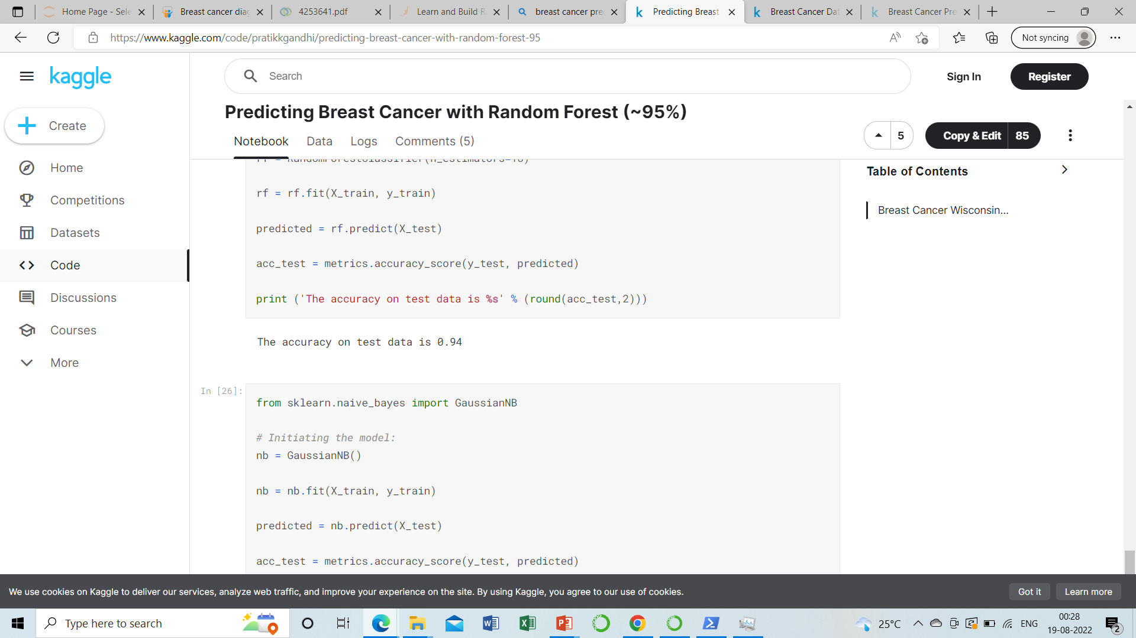
VISUALIZING THE TEST SET RESULT

Slide 17
CONCLUSION
I have using in Random Forest classifier model it is a best model in my idea.
Our model is able to predict with 94% accuracy of the test data. You can use many other techniques to find the best hyperparams to improve the accuracy.

Slide 18
THANK YOU

